Slide 1
Escape
Idea by: Yong Li
Prepared by: Yong Li

Slide 2
Statement
Given two integers N, M and a grid of N * M cells.
There are 4 types of cells:
wall (‘#’)
escape door (‘e’)
dog (‘d)
empty cell (‘.’)
A cell is called winning if there exists a path from the cell and it can reach an ‘e’ cell without getting bitten by 2 dogs.
Determine the number of winning cells

Slide 3
Subtask 1 (11 points): There is at most one dog on the grid
Since you need to get bitten by 2 dogs to lose, this subtask means that your HP is always positive. With that being said, we know that we can ignore the existence of dogs.
Hence, as long as you are able to reach an ‘e’ cell, the cell is winning. This can be done easily using BFS/DFS from each of the ‘e’ cells to paint the entire component (reachable cells).
The answer is the number of cells that is connected with an ‘e’ cell.
Time complexity O(NM)

Slide 4
Subtask 2 (13 points): N = 1
The grid is now 1 dimensional. WIth this, now we need to look closely and find out a pattern in which the player can win.
Observation: All cells that is second minimum distance of dogs to the escape door - 1 away from the escape door always win.
This is because we know that the moment we chose the path, the dogs will try to intercept the player midway. However, if it is able to intercept the play midway, it can “follow” the player until the escape door and bite him.

Slide 5
Subtask 2 (13 points): N = 1
Now, we want to compute the second minimum distance from the dogs. This can done easily with brute force.
For each cell, move left and right until we meet 2 dogs.
Then if there is <=1 dog, paint the entire component.
Otherwise, paint the cells that are second minimum distance - 1 away.
Output the number of winning cells.
Time complexity: O(M ^ 2)

Slide 6
Subtask 3 (15 points): N, M <= 10
Let us expand the previous task to a grid cell. In this subtask we can perform O((NM)^3) solution.
We can perform the below pseudocode:
For each cell (i, j):
For each cell (x, y):
Remove the dog on cell (x, y) if cell (x, y) is ‘d’
For each cell (a, b) that is a ‘d’:
Push into queue for bfs
Paint each cell that is second minimum distance - 1 away from each ‘e’ cell.
Then, check if the cell is winning.
Time complexity: O((NM)^3)

Slide 7
Subtask 4 (15 points): N, M <= 40
We can notice that from the previous task, we can notice that the inner two loops can be put outside and coloring the grid can be done later.
We can perform the below pseudocode:
For each cell (x, y):
Remove the dog on cell (x, y) if cell (x, y) is ‘d’
For each cell (a, b) that is a ‘d’:
Push into queue for multisource bfs
Record second minimum distance - 1 away from each ‘e’ cell.
For each cell (x, y):
If cell (x, y) is an ‘e’ cell, paint all cells that are second minimum distance - 1.
Time complexity: O((NM)^2)

Slide 8
Subtask 4 (15 points): N, M <= 40
Alternative solution:
Record all the distances from each dog. This can be done in O((NM)^2) using a DFS/BFS function.
Sort and find the second minimum distance, then perform similar operations as the previous task. This requires an O((NM)^2 log(NM)) time due to sorting.
Time complexity: O((NM)^2 log(NM))

Slide 9
Subtask 5 (17 points): There is at most one escape door.
The intention of this subtask here is to check whether the observation is found by the participants. With this subtask, we can locate the position of escape door, let us call it cell (x, y).
BFS from cell (x, y) until you meet two ‘d’ cells. Now you know how far away is the second minimum distance from the dogs. Then paint all the cells that is winning.
Note: We notice that if we expand this to more ‘e’ cells, the time complexity is O(NME) where E is the number of ‘e’ cells. This is our bottleneck and we want to optimize this at the next subtask.
Time complexity: O(NM)

Slide 10
Subtask 6 (19 points): N, M <= 2000
Now we can observe that we are somewhat close to full solving the question. We need to generalise the way that we find the second minimum distance. Instead of BFS from the escape door, we can do multisource BFS from the ‘d’ cells.
Note: It might be simpler to assign an id number to each of the dog cells to ensure that the same dog does not revisit the same cell twice and record the same dog twice.
Implementation: We can store two pairs of integers for each cell, {first_distance, first_dog} and {second_distance, second_dog}. With this, we can prevent counting the same dog twice.

Slide 11
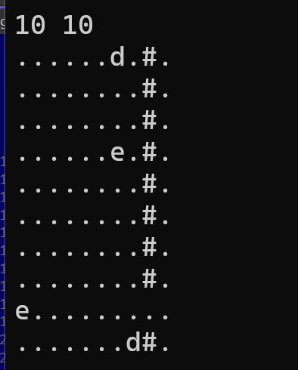
Subtask 6 (19 points): N, M <= 2000
Now we have the second minimum distance, but we cannot naively paint each cell to be winning. Multisource BFS!
We notice that we also cannot naively multisource bfs as a cell might be repainted and has a larger value left (to move around). This means that we need to prioritize the bigger values first.
This inspires a solution that uses set or priority queue to solve this subtask. Time complexity: O((NM) log (NM)).
If you cannot understand why we prioritize the larger values first, try looking at the grid below.

Slide 12
Subtask 7 (10 points): No other constraints.
Now, we can solve the problem with O((NM) log (NM)) but we can do better!
Instead or sorting naively, we notice that our values are at most N*M <= 9 * 10 ^ 6 and the actual upper bound is around NM/2 (from a spiral shape), which is around 4.5 * 10 ^ 6.
Instead of performing quick sort/heap sort, we can perform bucket sort! Bucket sort opens up “buckets” that has the “id” as the values. You can visualise it like layers of BFS, then you need to perform the queries from the larger values.
More information about bucket sort can be found here: geeksforgeeks
Time complexity: O(NM)

